Slide 1


NC811 Monthly update SEPTEMBER 2025
Lee county UCC

Slide 2
Upcoming Training: Underground Utility Safety & Damage Prevention Act (HB 247) Effective Date: October 1, 2025 What’s Changing: North Carolina’s Underground Utility Safety and Damage Prevention Act (House Bill 247) introduces key updates to excavation, notification, and facility marking procedures. Get Trained: Throughout September 2025, NC811 liaisons will host a series of free webinars to walk through all the changes in the law. 🔹 Who Should Attend: Utility operators, excavators, contractors, and anyone involved in underground utility work 🔹 Where to Register: Visit nc811.org/law for a full list of webinar dates and times 🔹 More Info: An email with training details will also be sent to all UCCs Stay informed. Stay compliant. Stay safe.

Slide 3

Meetings
STATE UCC – September 9, 10am Greenville Utilities, Greenville, NC
UDPRB – September 16, 9am NC811 Greensboro Office
NCLRPC – September 25, 11am NC811 Greensboro Office
NC811 BOARD – October 31, 8:30am Wrightsville Beach

Slide 4



NC State Football Game
Saturday,
September 27th
Carter–Finley Stadium Raleigh

Slide 5

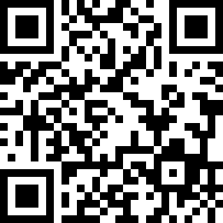
CALENDAR
NC811 & NCUCC event calendars can be found on nc811.org or the nc811 app

Slide 6


Locate Requests transmissions county ticket volume top 10 callers damage information
DATA INSIGHTS

Slide 7

Locate requests for NC AUG 25 vs 24
August 2025 – 267,755
August 2024 –​ 248,916 (7.5%) ​​
​​​​​
YTD 2025 – 2,080,713/ 2024 –​
​
1,889,666 = +10.11% ​​​​​
​​March​​
Updates for August (81,528)
​
= 30.44% of volume / 2025​
​
7.5%

Slide 8
Locate requests for NC year to date
??
August 2025 – 267,755
August 2024 –​ 248,916 (7.5%) ​​
​​​​​
YTD 2025 – 2,080,713/ 2024 –​
​
1,889,666 = +10.11% ​​​​​
10.11%

Slide 9
Transmissions for NC AUG 25 vs 24
??
August 2025 – 1,445,877
August 2024 –​ 1,348,384
​​
​​​​​
YTD 2025 – 11,213,428/ 2024 –​
​
10,219,030 = +7.2% ​​​​​
7.2%

Slide 10
Transmissions for NC year to date
??
August 2025 – 1,445,877
August 2024 –​ 1,348,384
​​
​​​​​
YTD 2025 – 11,213,428/ 2024 –​
​
10,219,030 = +9.7% ​​​​​
9.7%

Slide 11
County ticket volume
AUGUST 2025 vs 2024
Lee | 3 HR | CNCL | NEW | RXMT | UPDT | TOTAL Tickets
2024 | 126 | 39 | 1224 | 33 | 706 | 2128
2025 | 169 | 13 | 1151 | 39 | 596 | 1968
 | 34.1% | -66.7% | -6.0% | 18.2% | -15.6% | -7.5%
 |  |  |  | Locates per day |  | 89

Slide 12
County ticket volume
YTD vs previous year
Lee | 3 HR | CNCL | NEW | RXMT | UPDT | TOTAL Tickets
2024 | 851 | 155 | 8699 | 264 | 4545 | 14514
2025 | 1022 | 118 | 7771 | 354 | 5258 | 14523
 | 20.1% | -23.9% | -10.7% | 34.1% | 15.7% | 0.1%

Slide 13
County ticket distribution
AUGUST 2025
LEE | 1968
BLACKNEL | 6
BROADWAY | 44
CAROLINA TRACE | 6
COOL SPRINGS | 1
CUMNOCK | 2
JONESBORO HEIGHTS | 2
LEMON SPRINGS | 5
QUAIL RIDGE | 1
SANFORD | 1899
SWANN | 1
TRAMWAY | 1

Slide 14
Top 10 callers
AUGUST 2025
1 | MASTEC | 937
2 | TRUEROCK INC | 745
3 | NATIONAL ONDEMAND | 514
4 | ALL SIGNAL UNDERGROUND | 426
5 | PALMETTO UNDERGROUND SOLUTIONS | 411
6 | MASTEC | 397
7 | SOUTH COAST RESOLUTIONS | 334
8 | DIVERSIFIED UTILITY GROUP | 321
9 | WINDSTREAM COMMUNICATIONS | 206
10 | QUALITY PERFORMANCE FIBER COMMUNICATIONS | 159

Slide 15



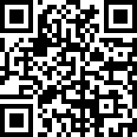
DAMAGES

Slide 16
Damages by county
AUGUST 2025
Total:1302
ALAMANCE | 10
ALEXANDER | 3
ALLEGHANY | 1
ANSON | 4
ASHE | 2
AVERY | 1
BEAUFORT | 2
BERTIE | 3
BLADEN | 3
BRUNSWICK | 12
BUNCOMBE | 27
BURKE | 1
CABARRUS | 18
CALDWELL | 9
CAMDEN | 1
CARTERET | 14
CASWELL | 2
CATAWBA | 29
CHATHAM | 12
CHEROKEE | 2
CHOWAN | 0
CLAY | 4
CLEVELAND | 8
COLUMBUS | 1
CRAVEN | 9
CUMBERLAND | 56
CURRITUCK | 3
DARE | 3
DAVIDSON | 20
DAVIE | 8
DUPLIN | 5
DURHAM | 95
EDGECOMBE | 0
FORSYTH | 27
FRANKLIN | 9
GASTON | 26
GATES | 0
GRAHAM | 0
GRANVILLE | 2
GREENE | 1
GUILFORD | 50
HALIFAX | 2
HARNETT | 24
HAYWOOD | 5
HENDERSON | 12
HERTFORD | 2
HOKE | 9
HYDE | 2
IREDELL | 24
JACKSON | 0
JOHNSTON | 40
JONES | 1
LEE | 7
LENOIR | 11
LINCOLN | 13
MACON | 0
MADISON | 1
MARTIN | 7
MCDOWELL | 3
MECKLENBURG | 169
MITCHELL | 0
MONTGOMERY | 8
MOORE | 29
NASH | 8
NEW HANOVER | 33
NORTHAMPTON | 5
ONSLOW | 19
ORANGE | 17
PAMLICO | 6
PASQUOTANK | 2
PENDER | 8
PERQUIMANS | 1
PERSON | 1
PITT | 23
POLK | 3
RANDOLPH | 14
RICHMOND | 2
ROBESON | 5
ROCKINGHAM | 5
ROWAN | 12
RUTHERFORD | 8
SAMPSON | 5
SCOTLAND | 7
STANLY | 7
STOKES | 7
SURRY | 5
SWAIN | 2
TRANSYLVANIA | 1
TYRRELL | 0
UNION | 43
VANCE | 2
WAKE | 172
WARREN | 0
WASHINGTON | 0
WATAUGA | 0
WAYNE | 10
WILKES | 5
WILSON | 7
YADKIN | 5
YANCEY | 0

Slide 17
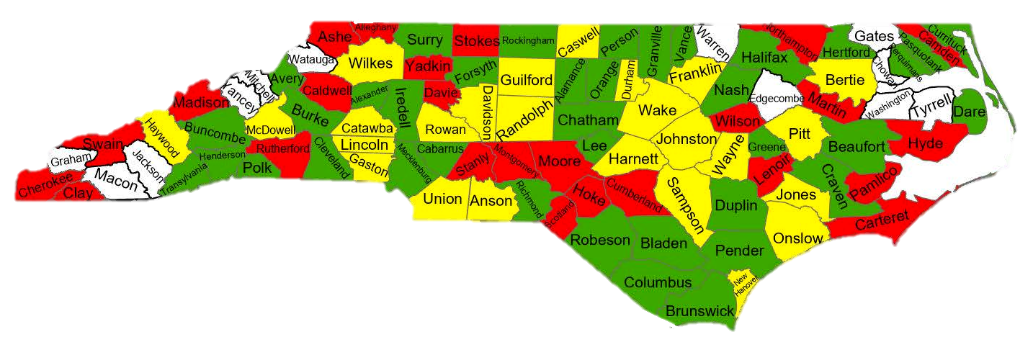
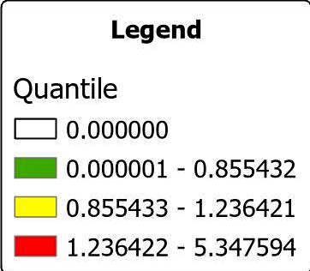
Damages per 1,000 transmissions
AUGUST 2025

Slide 19

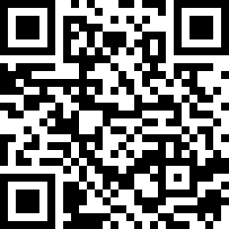
BROADBAND IN NC
In North Carolina, excavators must follow specific legal requirements to ensure safe and compliant underground work, including securing permits, requesting locates within a designated timeframe, and adhering to marking standards. These practices support the state's broader infrastructure goals, especially the expansion of broadband in rural areas, while protecting existing utilities.
https://nc811.org/broadband-in-nc/

Slide 20






NC811 Education team
Ann Rushing
Education Manager
Parrish Riddick
Education Liaison, Piedmont Region
Rory Phipps
Education Liaison, Western Region
Howard Corey
Education Liaison, Eastern Region
Tami Groves
Education Liaison, Southwest Region
Steve Moore
Media Relations Specialist

Slide 21


Thank you for your attention
A copy of this presentation will be available at
www.ncucc.org

